Slide 1

Digital Portfolio
STUDENT NAME: V.SUJEETHA
REGISTER NO AND NMID: asunm1735unm1735170
DEPARTMENT: Bsc.Cs(2nd year)
COLLEGE: Chennai college of arts and science
1
Notes:
1

Slide 2

PROJECT TITLE
portfolio
2

Slide 3



AGENDA
Problem Statement
Project Overview
End Users
Tools and Technologies
Portfolio design and Layout
Features and Functionality
Results and Screenshots
Conclusion
Github Link
3/21/2024 Annual Review
3

Slide 4

PROBLEM STATEMENT
A problem statement for a portfolio is a concise, clear description of a specific challenge or gap that the portfolio aims to address, supported by relevant context and impacts to stakeholders
4

Slide 5

PROJECT OVERVIEW
A project overview for a portfolio presents a high-level summary of the collection of projects, describing their objectives, key components, and how they align with strategic goals
5

Slide 6

WHO ARE THE END USERS?
The end users for a portfolio depend on the portfolio’s purpose but typically include hiring managers, human resources professionals, project managers, internal executives, and sometimes peer collaborators
6

Slide 7

TOOLS AND TECHNIQUES
Portfolio management tools include software like Microsoft Project, Smartsheet, Jira, and Planview, which help plan, track, and optimize projects within a portfolio. Key techniques involve resource allocation, risk management, project prioritization using scoring models, cost-benefit analysis, and portfolio roadmapping. These tools and methods together ensure that projects align with strategic business goals, risks are managed, resources are used efficiently, and performance is monitored effectively. This combination helps organizations maximize value and achieve portfolio objectives in a structured way.
7

Slide 8
POTFOLIO DESIGN AND LAYOUT
Portfolio design and layout focus on presenting work clearly, attractively, and logically to engage the audience effectively. Key principles include simplicity, visual hierarchy, and generous white space to make content easy to scan and understand. A well-structured portfolio typically starts with a concise introduction or bio, followed by categorized work samples or case studies, and ends with contact information. Consistency in fonts, colors, and alignment helps create a cohesive experience, while design choices should reflect the portfolio’s purpose and audience. Using templates or portfolio builders can speed up the process and ensure a polished look.
8

Slide 9
FEATURES AND FUNCTIONALITY
Portfolio management tools help organizations oversee collections of projects or investments efficiently. Popular tools like Monday.com, Asana, Wrike, and Clarizen provide features for project tracking, resource management, collaboration, risk analysis, and strategic alignment. These tools enable centralizing portfolio data, customizing workflows, monitoring performance, and optimizing resource allocation. Their functionalities support informed decision-making to maximize portfolio success and align projects with business goals in a structured and transparent way

Slide 10
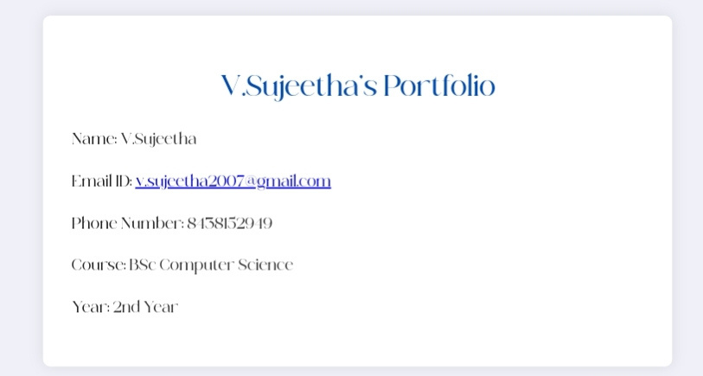

RESULTS AND SCREENSHOTS
3/21/2024 Annual Review
10

Slide 11
CONCLUSION
In conclusion, a well-designed portfolio is a powerful tool that showcases skills, creativity, and professional growth effectively. It should reflect your personal brand, highlight your best work, and tell the story behind each project, emphasizing your design process and problem-solving abilities. Keeping the portfolio focused, visually appealing, and regularly updated ensures it remains relevant to your target audience, whether potential employers or clients. Ultimately, a thoughtfully curated portfolio sets you apart in a competitive field and opens opportunities for career advancement and collaboration
11

